Slide 1

CG Power & Industrial Solutions Ltd
Leading India's power infrastructure transformation through innovation and strategic diversification

Slide 2




Company Overview
CG Power & Industrial Solutions Ltd is a leading Indian engineering company headquartered in Mumbai, specializing in power transmission, distribution, and automation solutions. Founded in 1937 and now part of the prestigious Murugappa Group, the company has established a strong presence across domestic and international markets.
Transformers
Motors & Drives
Essential for voltage conversion in power systems.
Powering industrial machinery and automation processes.
Switchgear & CBs
Railway Solutions
Protecting electrical circuits from damage.
Specialized systems for rail transport infrastructure.

Slide 3
Exceptional Financial Performance
₹8,046 Cr
₹1,427 Cr
₹6.37
28.6%
Operating Revenue FY25
Profit After Tax FY25
Earnings Per Share
Return on Equity
Remarkable 48% YoY growth demonstrating operational excellence
Delivering substantial value to shareholders
Industry-leading capital efficiency with virtually zero debt
Strong momentum with consistent 5-year CAGR of ~12%
Market capitalization stands at approximately ₹1.23 lakh crore, reflecting strong investor confidence in the company's growth trajectory and strategic positioning in high-potential sectors.

Slide 4

Q1 & Q2 FY2025: Strong Operational Momentum
Q1 FY2025 Highlights
Q2 FY2025 Performance
Consolidated revenue grew 25% YoY to ₹2,643 crore
Revenue increased 21% YoY to ₹2,413 crore
Net Profit stood at ₹286 crore
Net profit at ₹220 crore amid strategic investments
EBITDA margin at 15.4% with ₹407 crore EBITDA
EBITDA of ₹324 crore supporting expansion
Order intake surged 56% YoY to ₹4,764 crore
Order intake grew 42% YoY
Robust order backlog of ₹11,971 crore
Strong backlog maintained at ₹7,965 crore
Free cash flow exceeded PAT by 119%
Margin pressures from acquisition costs offset by solid operational performance and future visibility
Power Systems segment led with 43% growth; Industrial Systems grew 16%

Slide 5
Management Commentary & Strategic Vision
"We have a very strong start of this fiscal year with all-time high quarterly standalone revenue and PBT. Our Q1 sales grew by 25% year-over-year, profit after tax grew by 23%, and order intake grew by 56%, making it one of the strongest quarterly performances in recent times."
01
02
Operational Excellence Focus
Strategic Acquisitions
Management emphasizes improving efficiency while expanding business segments like power systems and semiconductors
Active pursuit of growth opportunities including $36M Renesas RF components acquisition and semiconductor foray
03
04
Future Expansion Plans
Long-term Visibility
American Railroad Association certification and new sector integration expected to drive railway segment growth
Consistent order intake growth and strategic investments position company for sustained expansion
CEO Amar Kaul noted that despite short-term margin pressures from acquisitions, the strong backlog and rising demand for power systems will drive future profitability.

Slide 6

Strategic Growth Initiatives & Market Context
Major Recent Developments
Semiconductor Entry
Launched India's first full-service OSAT facility in Sanand, Gujarat via CG Semi subsidiary—commercial production starts FY26
Strategic Acquisition
Acquired Renesas RF components business for $36M, expanding presence in India, USA, China, and Turkey
Infrastructure Orders
Secured ₹641 crore contract from Power Grid Corporation for high-voltage transformers and reactors
Capital Raise
Raised ₹3,000 crore through QIP to fund expansion and strategic initiatives
Industry Tailwinds
Indian electrical equipment sector growing at ~10% CAGR, driven by government initiatives like PLI schemes, Green Energy Corridors, and the ₹76,000 crore Semiconductor Mission. Rising infrastructure investments, railway modernization, and electrification trends create sustained demand for CG Power's diversified portfolio.

Slide 7
Ratios
Liquidity Ratios
Profitability Ratios
Current Ratio = Current Assets / Current Liability
Gross Profit Margin = (Gross Profit / Revenue) * 100
Quick Ratio = (Current Assets − Inventory) ÷ Current Liabilities
Operating Profit Margin = (EBIT / Revenue) * 100
Return on Equity (ROE) = (PAT / Average Shareholders' Equity) * 100
Return on Capital Employed (ROCE) = (EBIT / Capital Employed) * 100

Slide 8
Ratios
Valuation Ratios
Efficiency Ratio
Earnings per share (EPS) = Net Profit / No. of shares
Inventory Turnover Ratio = Revenue / Average Total Inventory
Price to earnings ratio = Market Price per share / EPS
Assets Turnover Ratio = Revenue / Average Total Assets

Slide 9
RATIOS
Revenue from Operations
2,752.77
2,878.05
Cost of Goods Sold (B):
Cost of materials consumed
1,873.51
1,923.59
Purchases of stock-in-trade
104.21
104.19
Changes in inventories*
-44.46
-20.16
Total COGS-related Expenses (B)
1,933.26
2,007.62
Gross Profit (A - B)
819.51
870.43
PBT
383.64
363.78
PAT
274.26
266.87
Revenue/Profits (Consolidated, ₹ Cr)
10.04
10.78
Interest Expense (Consolidated, ₹ Cr)
2.75
2.19
EBIT
386.39
365.97
Operating profit margin
0.14
0.13
Gross profit margin
0.30
0.30
ROE (Return on Net Worth)
0.29
0.27
ROCE (Return on Capital Employed)
0.39
0.35
ROE/ROCE
0.75
0.76
Basic EPS (₹)
1.80
1.87
Interest Coverage Ratio (Calculated)
139.5x
166.1x
Total Current Assets
5,251.33
5,251.33
Total Current Liabilities
3,125.70
3,125.70
Inventory
1,136.71
1,136.71
Inventory Turnover Ratio
1.70
1.77
Assets Turnover Ratio
1.48
1.55
Current Ratio
1.68
1.68
Quick Ratio
1.32
1.32

Slide 10
Comparison With Peers
Company
Operating Profit Margin (%)
Gross Profit Margin (%)
ROE (%)
ROCE (%)
Current Ratio
Inventory Turnover (x)
Asset Turnover (x)
CG Power and Industrial Solutions
13
30
27
35
1.68
1.77
1.55
Siemens Ltd (India)
17
15
20
1.9
1
ABB India
25
26
35
2.04
3.55
1.03
Schneider Electric (India)
22
28
47
1.6
BHEL
5
2
10
1.4
1.2
0.9

Slide 11
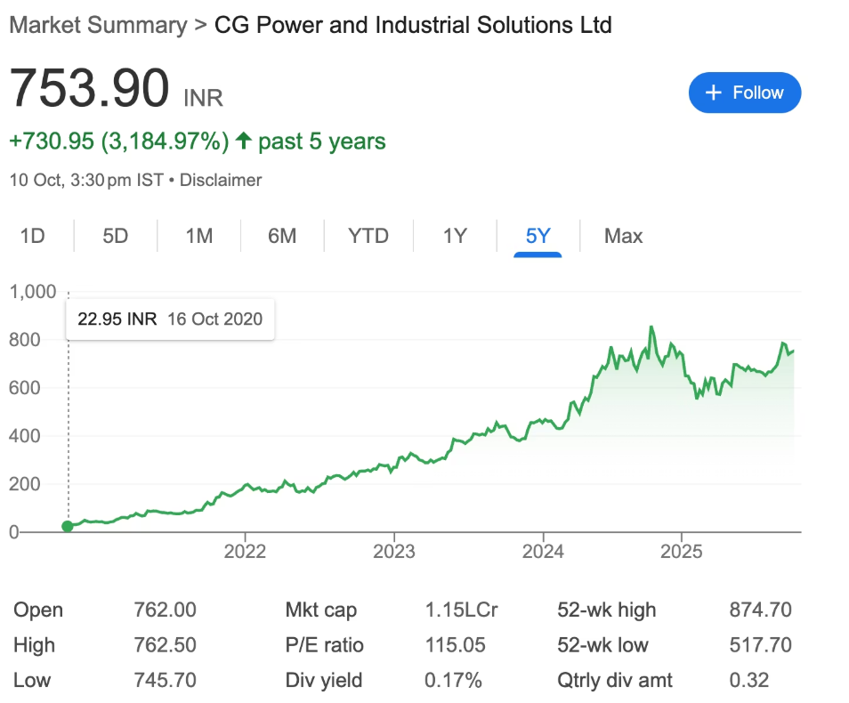
Investment Recommendation: BUY & HOLD
Investment Thesis
Superior Financial Performance
30% gross profit margin, 27% ROE, and debt-free balance sheet demonstrate exceptional operational strength
Strategic Market Position
Market leadership in power equipment combined with semiconductor diversification creates multiple growth engines
Strong Order Visibility
₹641 crore Power Grid contract and robust backlog provide revenue certainty through FY26
Weaknesses
Weaker ROE and ROCE than Schneider Electric, smaller market size than other peers, no government advantage like BHEL
Sources: Equitymaster Research, Moneycontrol, Morgan Stanley Reports, NSE Disclosures, CG Power Investor Relations
ScanX Trade, reporting Q1 results and revenue growth details. • 5paisa, highlighting Q2 results, YoY trends, and detailed financial breakdowns. • Business Standard article, discussing net profit decline and operational cost impacts in Q2. • Bajaj Broking FY24-25 earnings summary, providing Q2 management commentary and order intake data. • Yahoo Finance and Marketscreener, containing transcripts and commentary from CG Power’s Q1 and Q2 earnings calls. • Other supporting context from Moneycontrol, NSE, and CG Power’s investor relations disclosures.

